Slide 1
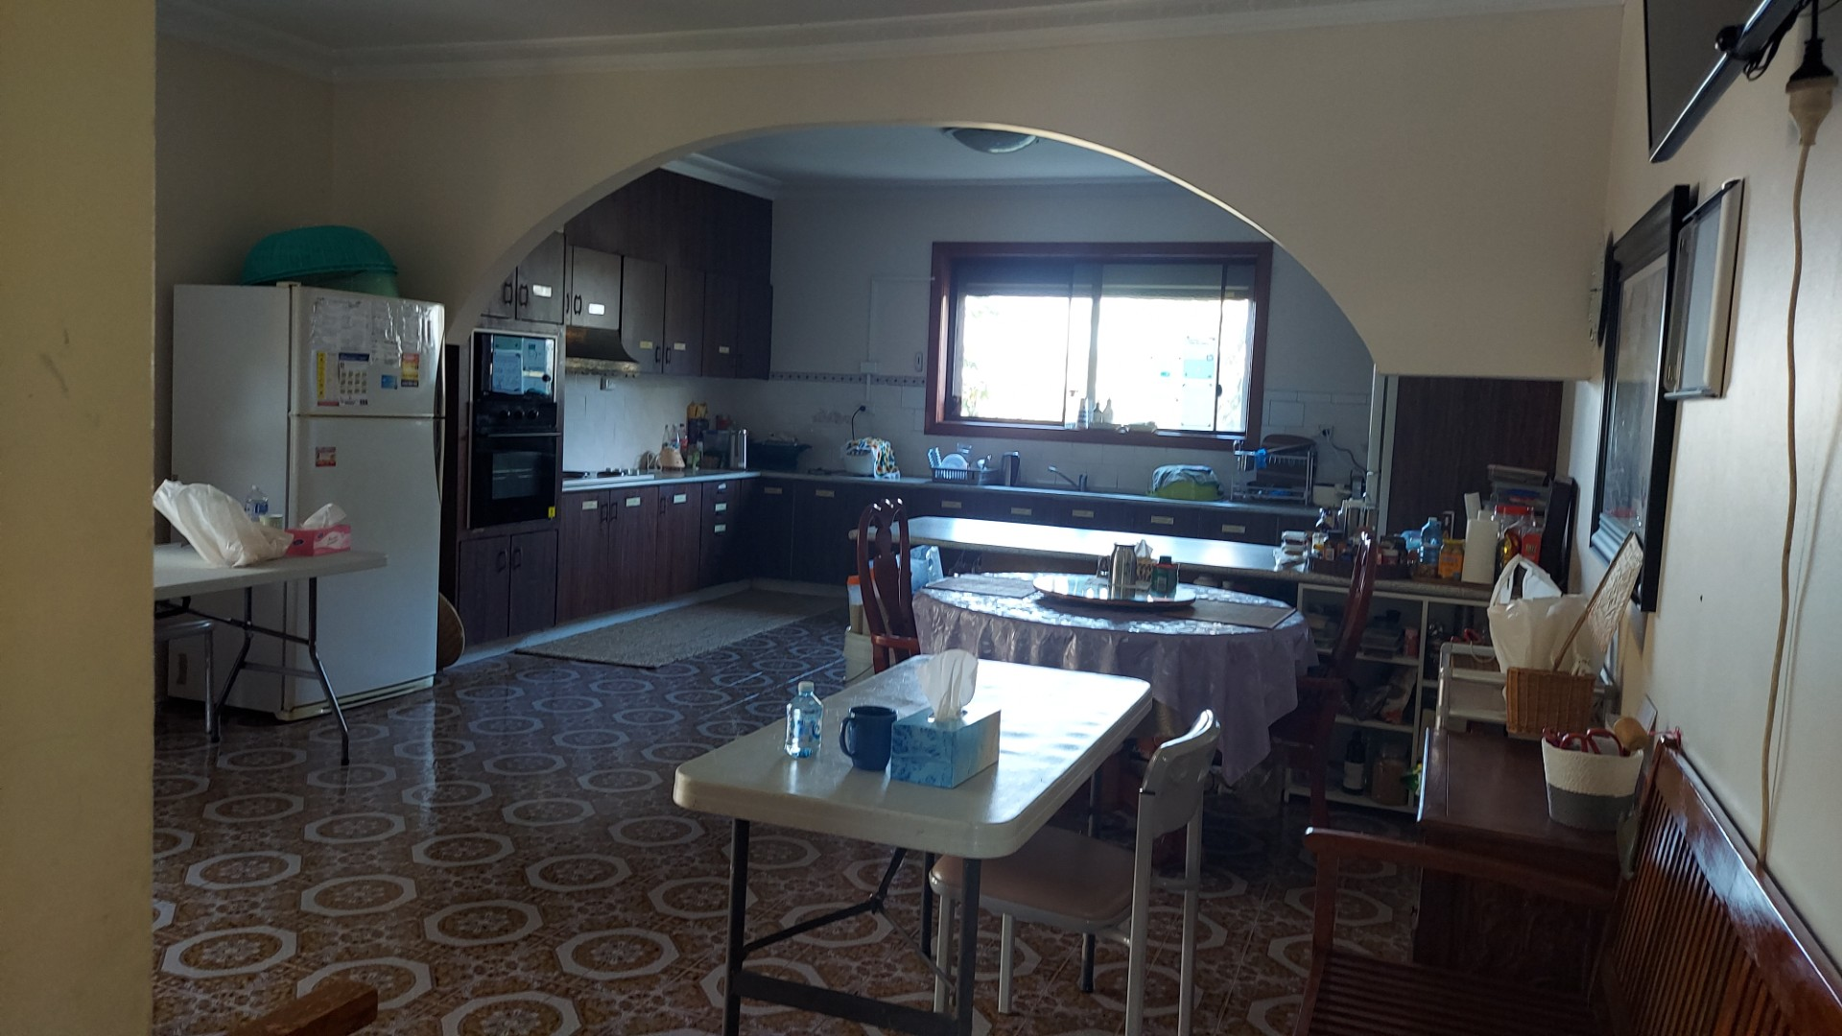
Existing Kitchen:

Slide 2
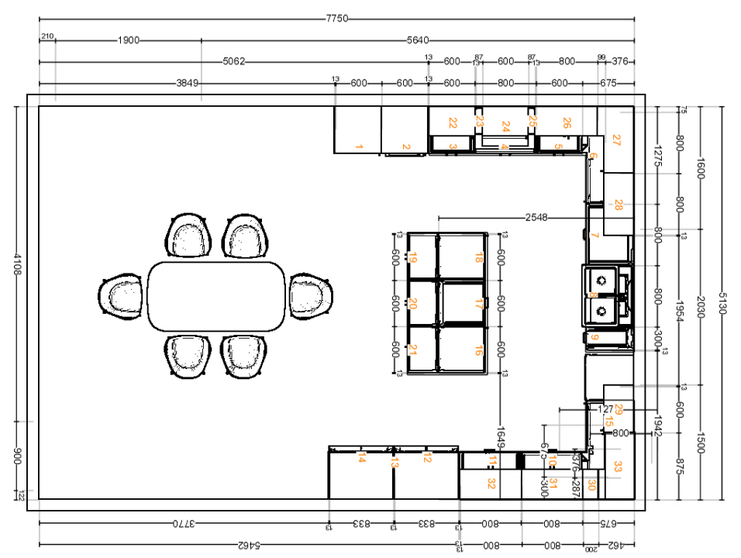
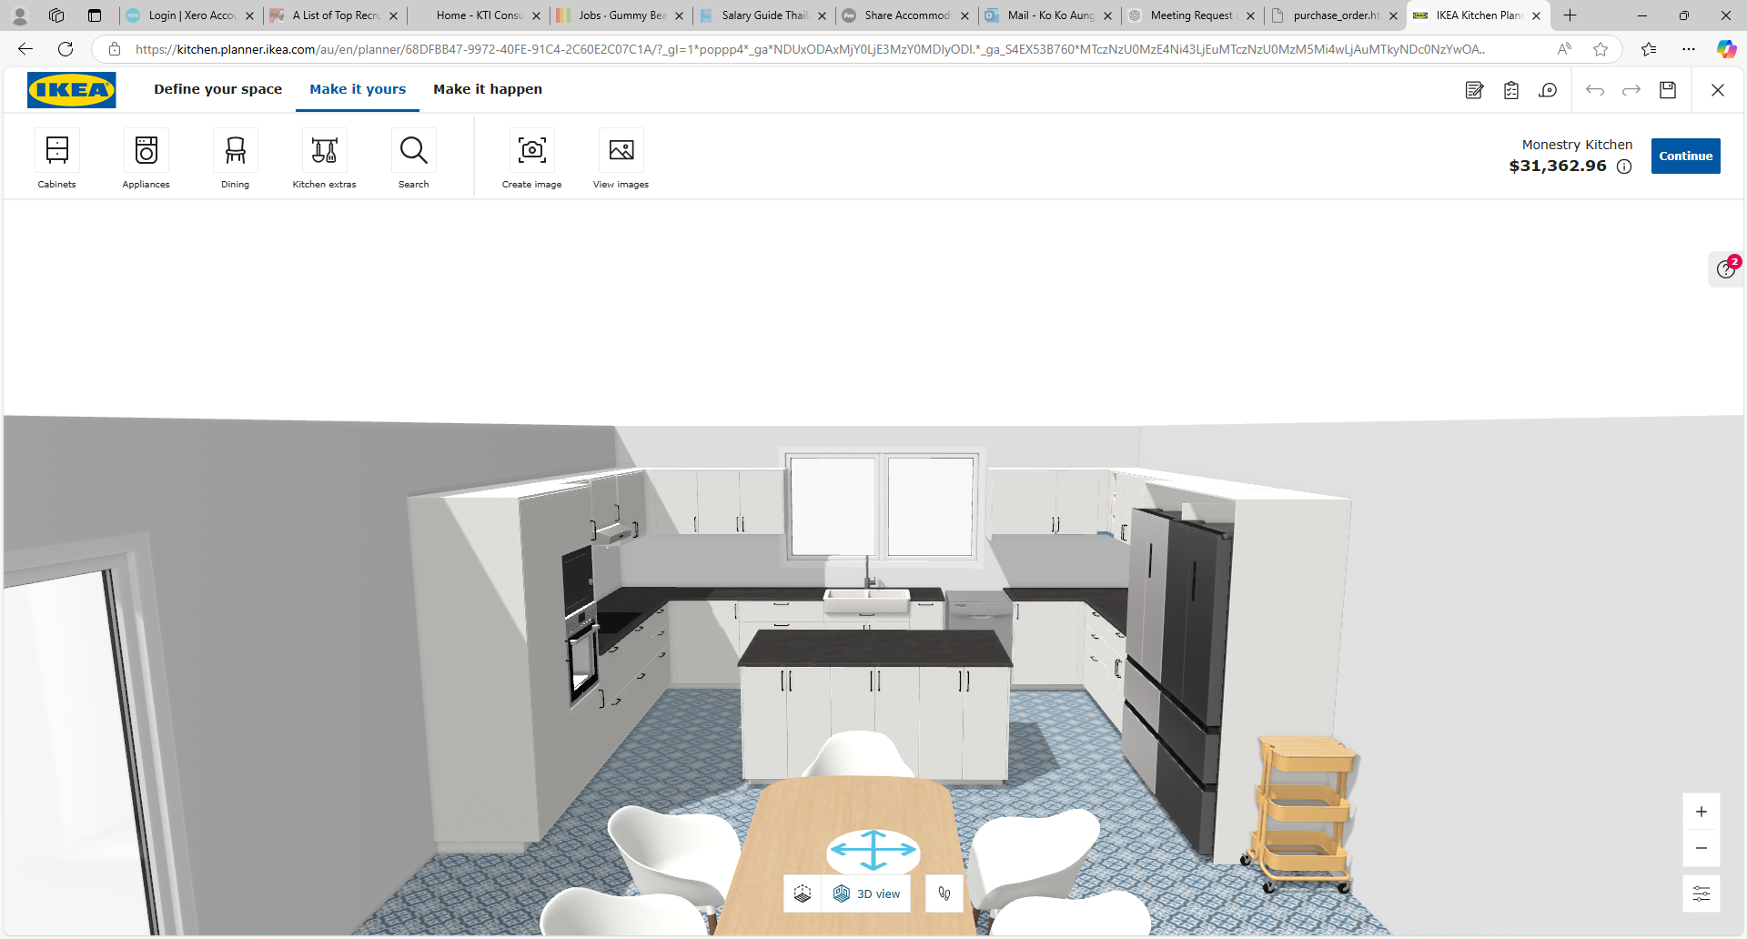
Proposed Kitchen:

Slide 3
Proposed Kitchen:

Slide 4
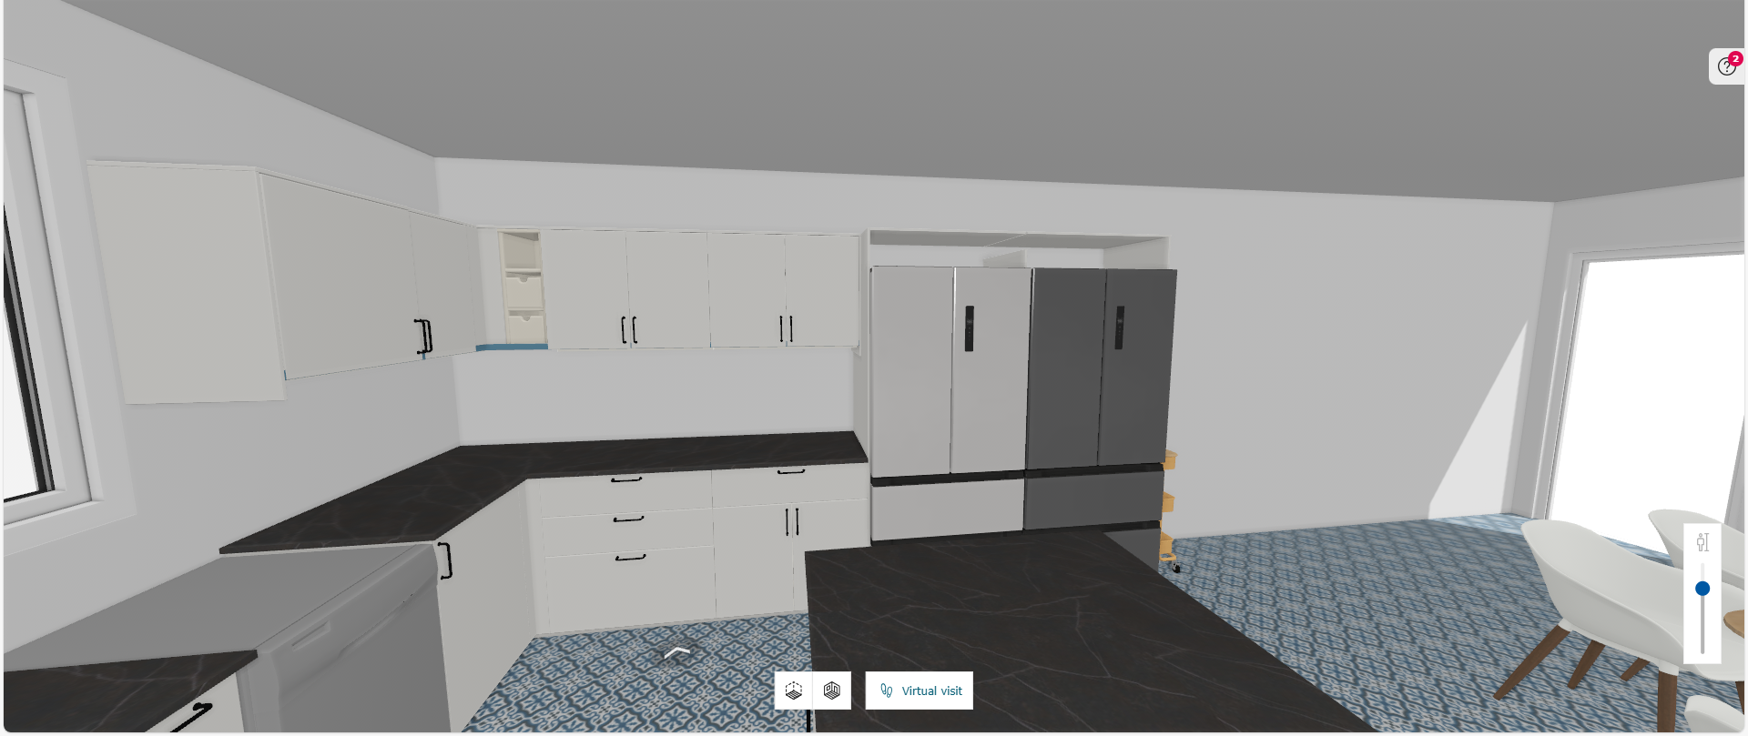
Proposed Kitchen:

Slide 5
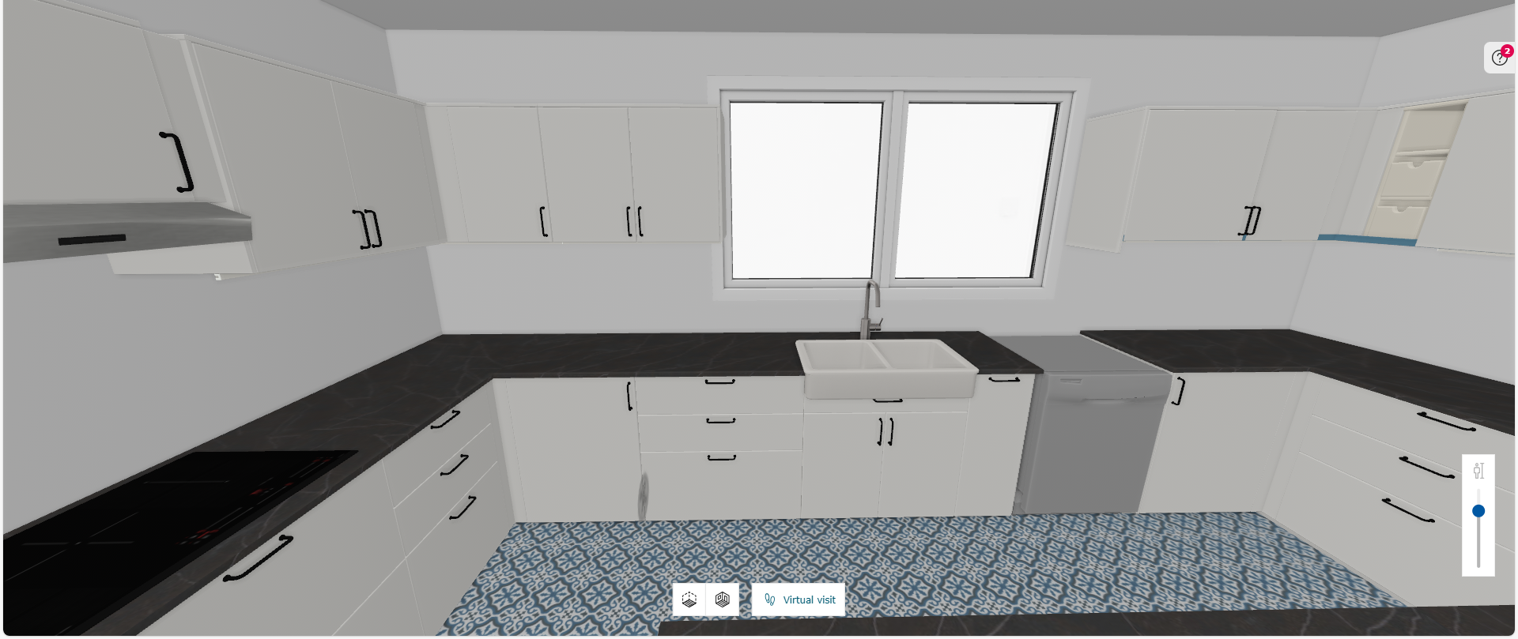
Proposed Kitchen:

Slide 6
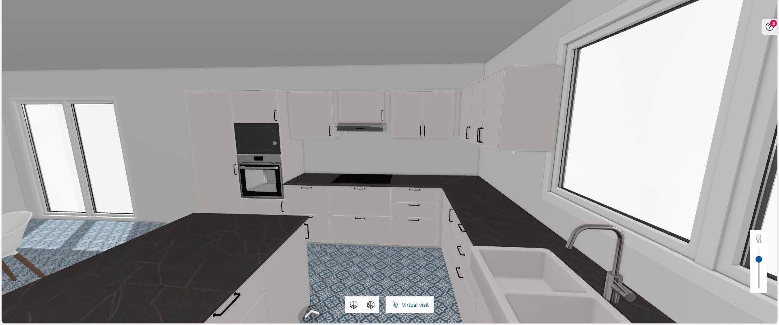
Proposed Kitchen:

Slide 7
